Slide 1
Indexing Methods

Slide 2
Indexes
Index Files
  Secondary or auxiliary files that help speed up data access in primary files
Single level index
  index file maps directly to the block or the address of the record
Multi-level index
  multiple levels of indirection among indexes

Slide 3
Definitions
Indexing field (indexing attribute): The field on which an index structure is built (searching is fast on this field)

Slide 4
Indexes as Access Paths
A single-level index is an auxiliary file that makes it more efficient to search for a record in the data file.
The index is usually specified on one field of the file (although it could be specified on several fields).
One form of an index is a file of entries <field-value, pointer-to-record> which is ordered by field-value.

Slide 5
Indexes as Access Paths
The index is called an Access Path on the field.
The index file usually occupies less disk blocks than the data file because its entries are much smaller.
A binary search on the index yields a pointer to a file record.

Slide 6
Primary Index
  Defined on an ordered data file
  Data file is ordered on a key-field
  Includes one index for each block in the data file; the index entry has a key field value for the first record in the block, which is called the block anchor.

Slide 7
Primary Index
RollNo
Name
Age
Gender
Grade
Index File
2003-0101
…..
…..
2003-0101
2003-0120
2003-0121
…..
2003-0121
…..
…..
…..
2003-0181
2003-0140
…..
.
.
2003-0201
.
.
.
2003-0221
…..
…..
2003-0221
2003-0240
…..
.
.
2003-0241
…..
2003-0262
…..
2003-0262
…..
2003-0280
K(i)
P(i)

Slide 8
Clustering Index
  Defined on an ordered data file
  Data file is ordered on a non-key-field
  Includes one index entry for each distinct value of the field; the index points to the first data block that contains records with that field value.

Slide 9
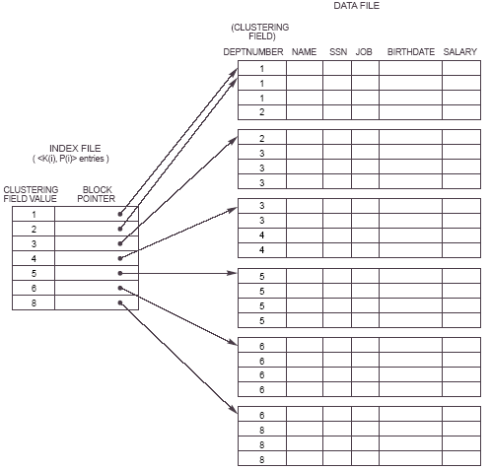
Clustering Index

Slide 10
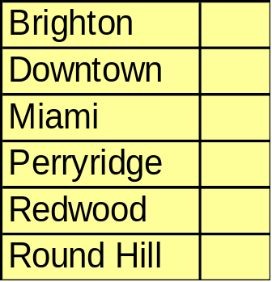
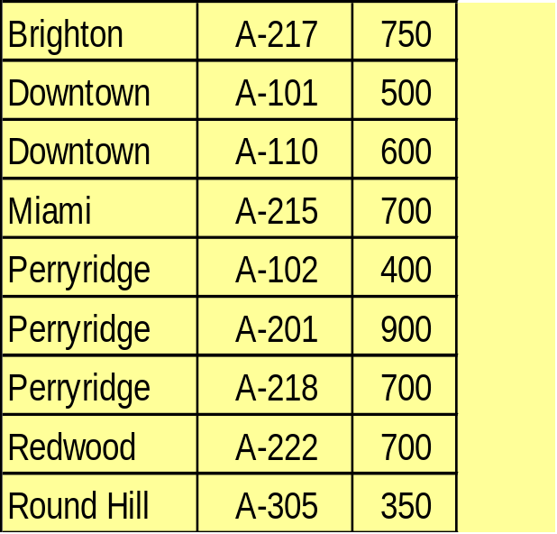
Dense Index Files
Dense index – index record appears for every search-key value in the file.

Slide 11
Sparse Index Files
A clustering index may be sparse.
Index records for only some search-key values.
To locate a record with search-key value k we:
  Find index record with largest search-key value < k
  Search file sequentially starting at the record to which the index record points
Less space and less maintenance overhead for insertions and deletions.
Generally slower than dense index for locating records.

Slide 12
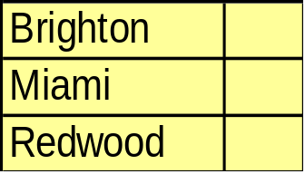
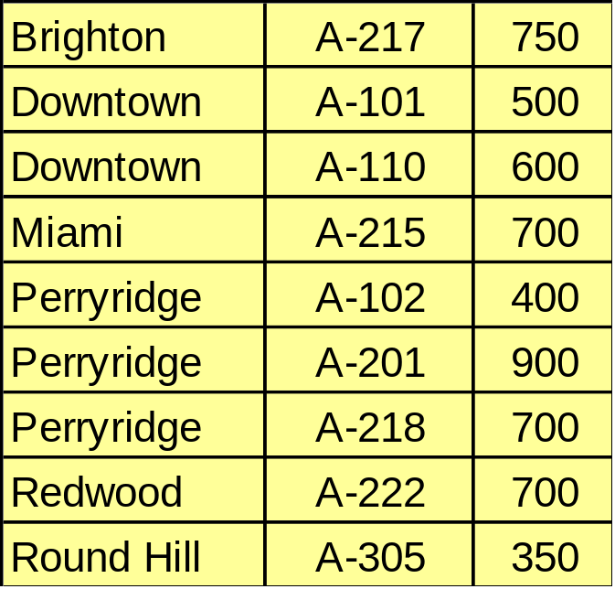
Sparse Index Files

Slide 13
Secondary Index
  Defined on an unordered data file
  Can be defined on a key field or a non-key field
  Includes one entry for each record in the data file

Slide 14
Secondary Index on Key Field
RollNo
Name
Age
Dept No
Job
K(i), A(i)
2003-0101
2003-0107
2003-0101
2003-0103
2003-0102
2003-0102
2003-0103
2003-0105
2003-0104
2003-0104
2003-0106
2003-0105
2003-0106
2003-0107
…
Has as many index entries as the number of records…

Slide 15
Secondary Index on Key Field
Since key fields are unique, number of index entries equal to number of records

Slide 16
Secondary Index on non-key Field
When a non-key field is indexed, duplicate values have to be handled.
There are three different techniques for handling duplicates:
  Duplicate index entries
  Variable length records
  Extra redirection levels

Slide 17
Duplicate Index Entries
Index entries are repeated for each
duplicate occurrence of the non-key
attribute.
K(i) A(i)
2003-0101
2003-0102
2003-0102
2003-0102
2003-0102
2003-0103
2003-0103
…

Slide 18
Variable Length Records
Use variable length records for index table in order to accommodate duplicate key entries
For a given key K(i), there is a set of address pointers instead of a single address pointer

Slide 19
Extra Redirection Levels
RollNo
Name
Age
LabId
Grade
1
2
2
K(I) A(I)
3
4
1
1
2
3
.
.
.
.
4
1
1
2
Address
Blocks
3
4
1

